Slide 1
A Machine Learning Approach to American Sign Language Interpretation
Marieke Sorge and Mikayla Geiger

Slide 2
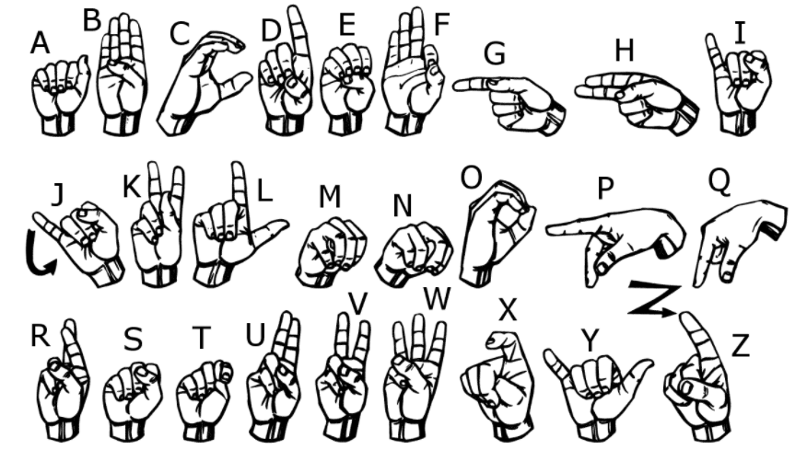
The Application
-American Sign Language (ASL) is used by 50,000-500,000 Americans
-No readily available tools to translate ASL to spoken (or written English)
-Use machine learning techniques to classify letters of the ASL alphabet and apply to an instructional video.

Slide 3
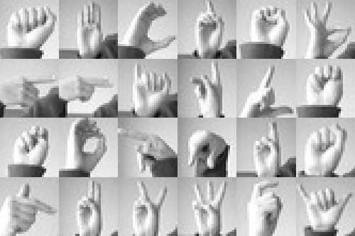
Pixel Data
-Pixel Values
-28x28 grayscale images
-27,455 training cases
-7172 test cases
-24 classes of letters (excluding J and Z which require motion).

Slide 4
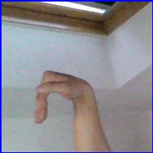
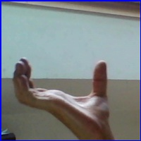
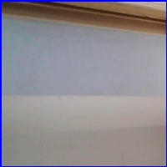
The Data
29,000 images which are 100x100 pixels. There are 29 classes, of which 26 are for the letters A-Z and 3 classes for space, delete and nothing.
delete
Space
Nothing

Slide 5
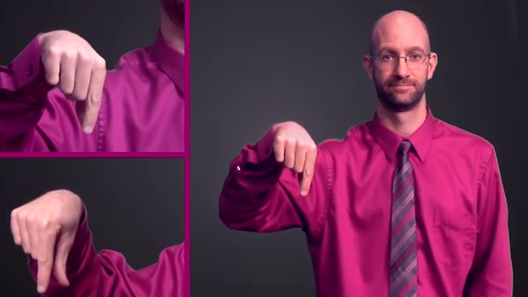
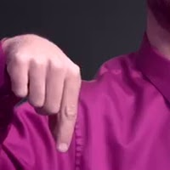
Instructional Video Data
Preprocessing
Import video .mp4 file from youtube
Segment into frames 1/2sec
Crop and resize
Normalize pixel values

Slide 6
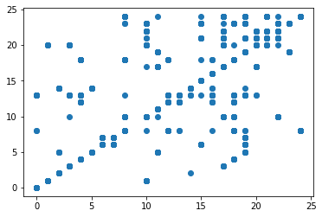
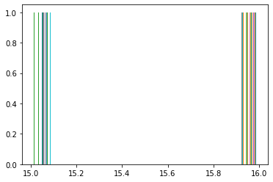
Random Forest Using Pixel Values
Accuracy: 0.82 on testing data
Only predicts two values 15 “O” and 16 “P” for video stills

Slide 7
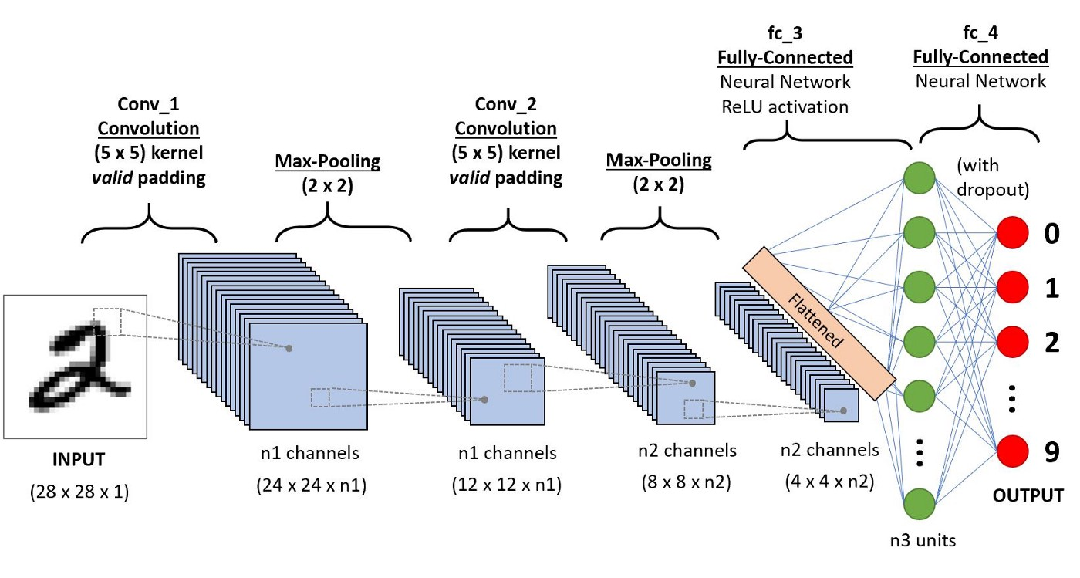
Convolutional Neural Network
-2 convolutional layers (without dropout)
-1 dense layer
-effective at reducing dimensionality (good for high dimensional data like images) while maintaining model quality
https://towardsdatascience.com/a-comprehensive-guide-to-convolutional-neural-networks-the-eli5-way-3bd2b1164a53

Slide 8
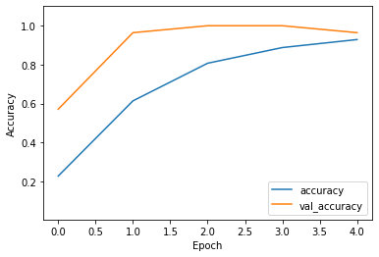
Testing Data set Results:
Achieves ~.88 training accuracy in a few epochs
Validation accuracy is much higher than training accuracy
Validation set consisted of just one image from each class, except ‘delete’

Slide 9
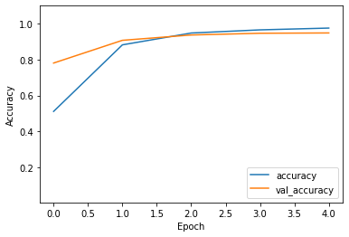
Increased Testing Data
Used the 29,000 training images and split the data:
Training: 90%
Testing 10%
Accuracy improved to ~95%
Validation and Training accuracy is similar

Slide 10
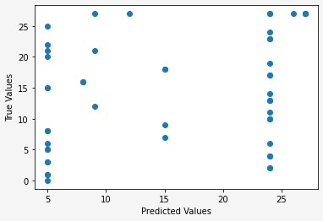
Instructional Video Results
Predicting the images from the video only gives ~12.24% accuracy
Usually predicts ‘F’ or ‘Y’

Slide 11
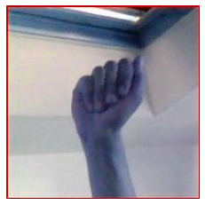
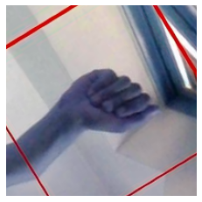
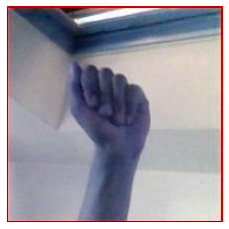
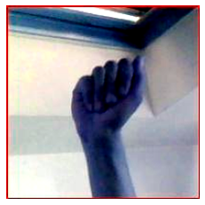
Methods to Improve Predictions
Data augmentation
Original
Rotated
Flip
Contrast

Slide 12
Methods to Improve Predictions
Dropout
Randomly drops neurons from layer
Padding=’same’
Full image is used each time
Added additional layers
Changed pool-size in MaxPooling2d
Increases size of input window
Added Global Average Pooling Layer
Increased number of Epochs to 50

Slide 13
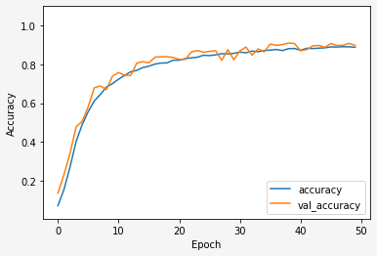
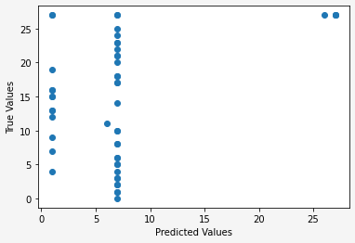
New Model
Validation: ~89% accuracy
Prediction:
8.16% accuracy

Slide 14
Possible Issues
Shirt in the image
Color of the images
Dark background vs. light background
Training Set
Prediction Set

Slide 15
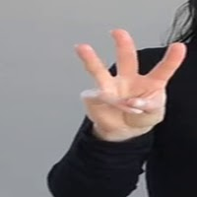
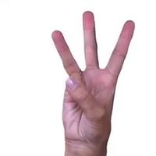
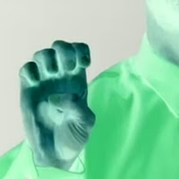
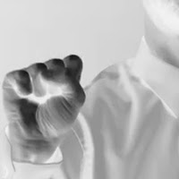
Other Video Image Preprocessing Techniques
Different Video no shirt obstruction
Different Video
Inverted Color
Inverted Grayscale

Slide 16
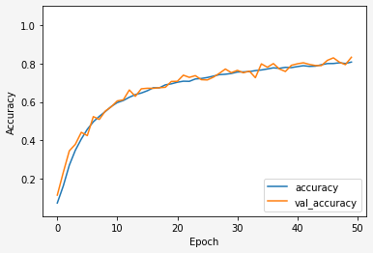
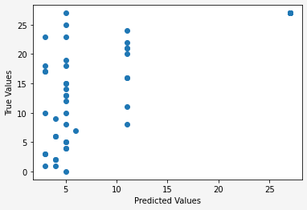
Inverted Grayscale
Best model for prediction so far
Accuracy is still low at ~24%

Slide 17

Conclusions and Future Research
For our project:
Improve ability to predict for video image stills
For Future Projects:
Improving accessibility
Expand to include ASL words
Expand to sentences for real-time interpretation

Slide 18
References
Image data source:
[Akash]. ([2017]). [ASL Alphabet], [Version 1]. Retrieved [11/11/2021] from [https://www.kaggle.com/grassknoted/asl-alphabet].
Pixel data source:
[tecperson]. ([2017]). [ASL Alphabet], [Version 1]. Retrieved [11/02/2021] from [https://www.kaggle.com/datamunge/sign-language-mnist].

Slide 19
Questions?

